Slide 1
Car Parking Slot Management
Submitted in the partial fulfillment for the award of the degree of
BACHELOR OF ENGINEERING
IN
ARTIFICIAL INTELLIGENCE AND
MACHINE LEARNING
Submitted by:
Arnav R Patnaik
20BCS6658
Sai Rahul
20BCS6670
Under the Supervision of:
Mr. Dinesh Vij
Department of AIT-CSE
Section-20AIML3-B
DISCOVER . LEARN . EMPOWER

Slide 2
Outline
Sr.no | Title | Page number
1 | Introduction to Project | 3-4
2 | Problem Formulation | 5
3 | Objectives of the work | 6
4 | Methodology used | 7-8
5 | Results and Outputs | 9-15
6 | Conclusion | 16
7 | Future Scope | 17
8 | References | 18

Slide 3
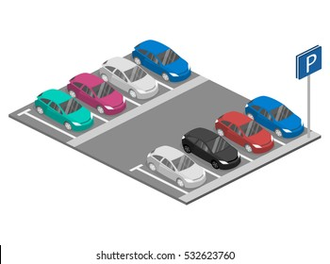
Introduction to Project
Over the years, we have seen that the population has exponentially increased. Due to which there has been a huge spike in the purchase of vehicles.
[1] A survey based on the preference of transport in pre and post covid period was conducted by RESEARCH AND MARKETS in which they interviewed more than 350 2-wheeler and 4-wheeler owners from various age groups.
Some key findings of the survey showed that there has been a significant shift from public transport to personal transport as 56% of respondents were apprehensive about hygiene and lack of social distancing.
So, more space will be required to park a vehicle. In apartments, societies, and shopping areas, we have seen that finding a suitable parking area has become a severe issue.

Slide 4
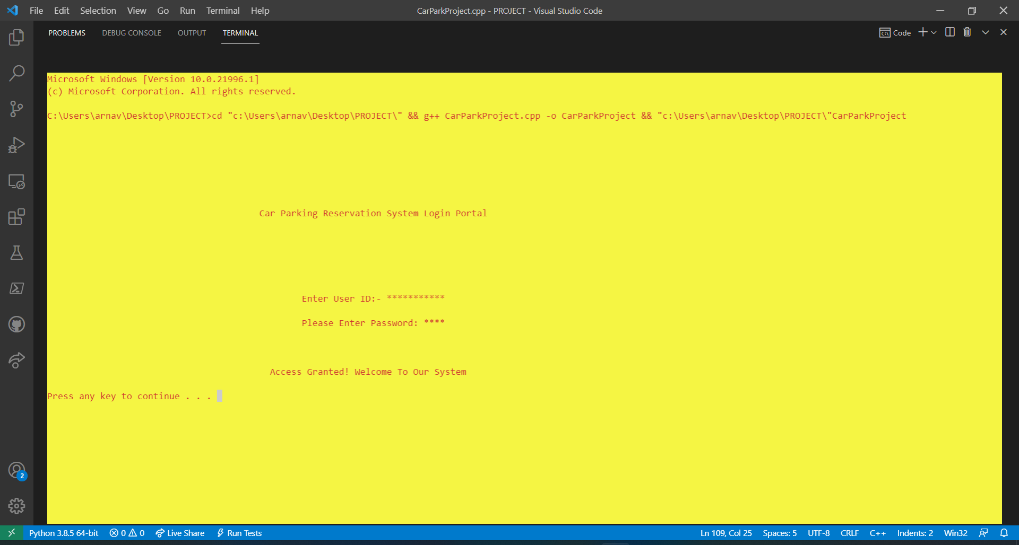
Our project work is on Car parking slot management system which is Compiler- Based.
It stores the customer’s name, phone number, car number, hours of stay and the amount to be charged.
It has a secured login system that requires the user id and password.
The user id and password are encrypted to provide better security from the operator’s end.
The total number of vehicles that are being parked can be recorded.
Parking expenses of the customer’s vehicles record are maintained.
The records of the customers can be deleted.
The ticket can be printed to give to the customer or just for maintaining the records.

Slide 5
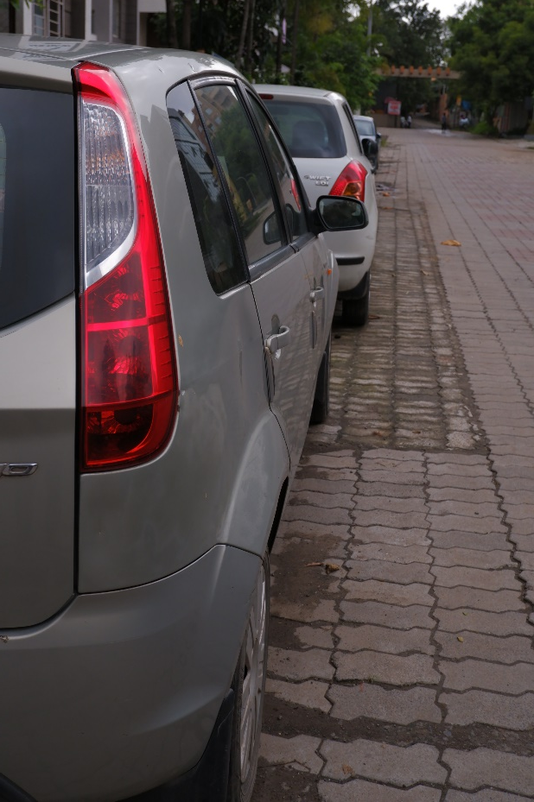
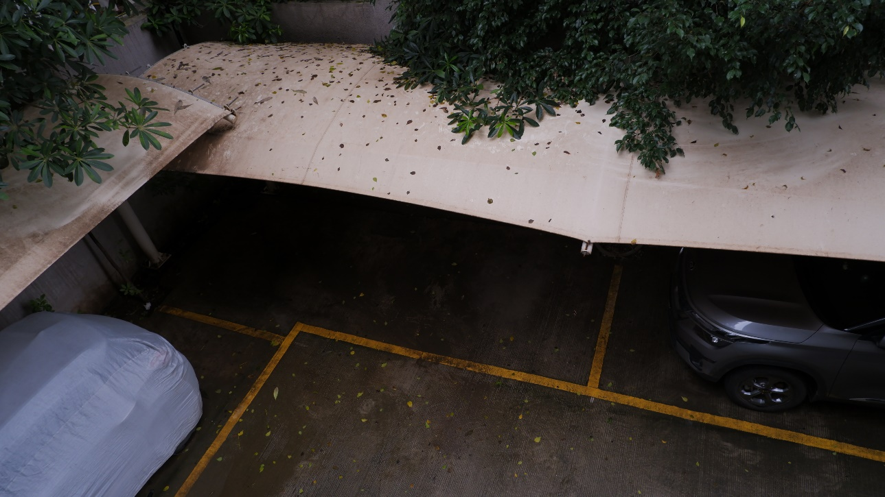
Problem Formulation
The major problem arising in this research project is that how to manage the problem of car parking in small residential areas, apartments, commercials, and the streets.
It is important to resolve this issue as it creates chaos amongst the drivers who are not able to get a slot or parking area to park their vehicle.
This issue gets severe when a person owns a car or 4-wheeler as it requires a bigger area.

Slide 6
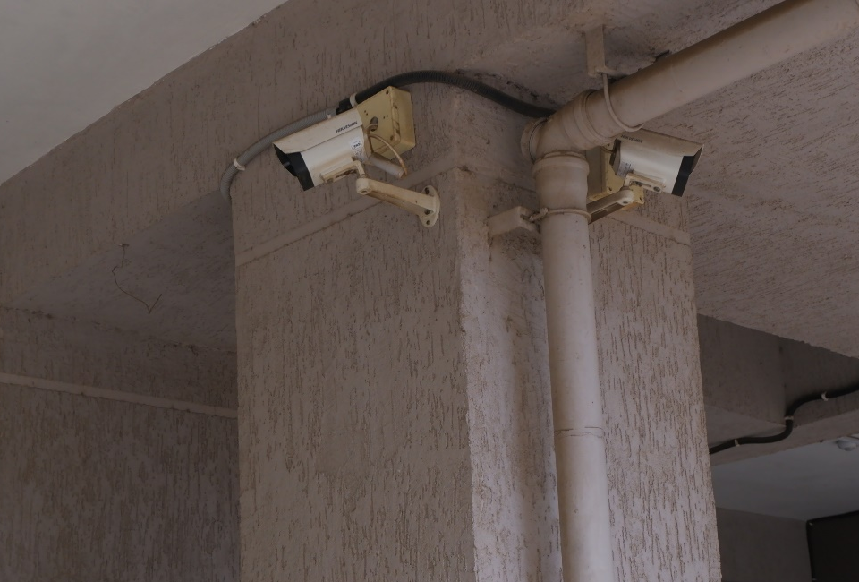
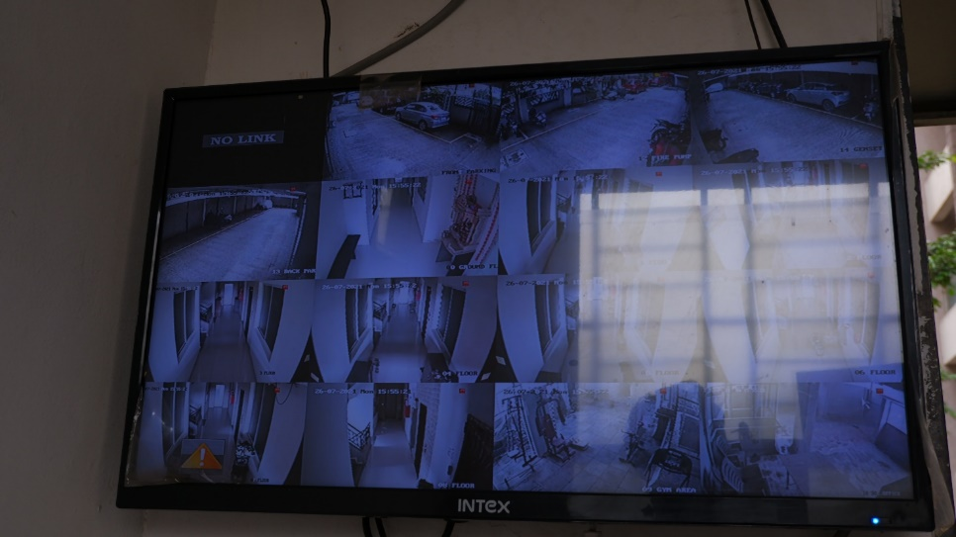
There is a need to keep all the cars organized and secure in their parking slots which can only be done by this program as it stores all the information as records real-time into the memory.
To resolve this issue we came up with a system in which the operator can assign the slots to the vehicles and a system of proper car management can be initiated.
Our program is compiler-based in which the operator will be able to add the details of the customer, their vehicle, and the parking charges as well.
This car parking management system also has a secure login portal which makes it more secure and accessible to the user/admin/management.

Slide 7
Objectives
The main objective of this Car Parking Slot Management System which is based on C++ is to:
manage the details of the customer like vehicle number, phone number, stay hours of their parked vehicle, Parking slots.
Focus on the administrative end.
reduce the manual work for managing the customer and their vehicle details
Create a reliable system, which provides accuracy, keeps the system secured, and is cost-effective.

Slide 8
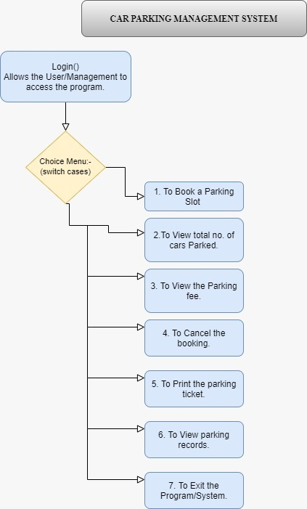
Methodology used

Slide 9
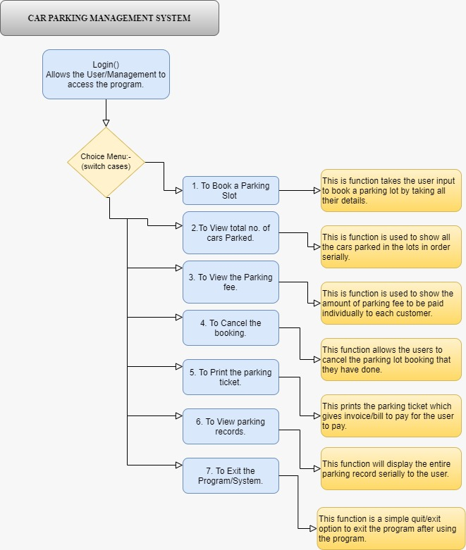
Methodology used

Slide 10
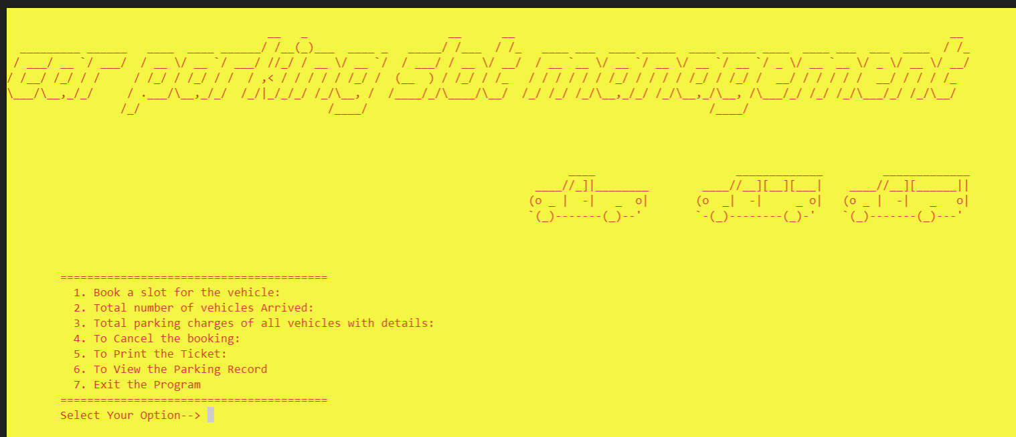
Results and Outputs
This is the login page of our car parking slot management system.
It asks for the user id and the password without which the access will be denied.
This is our dashboard in which the user can use various functionalities.

Slide 11
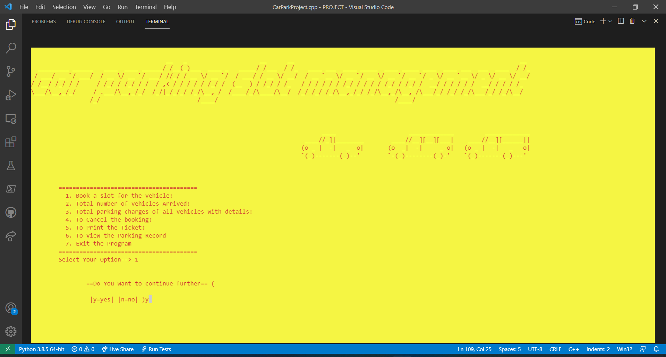
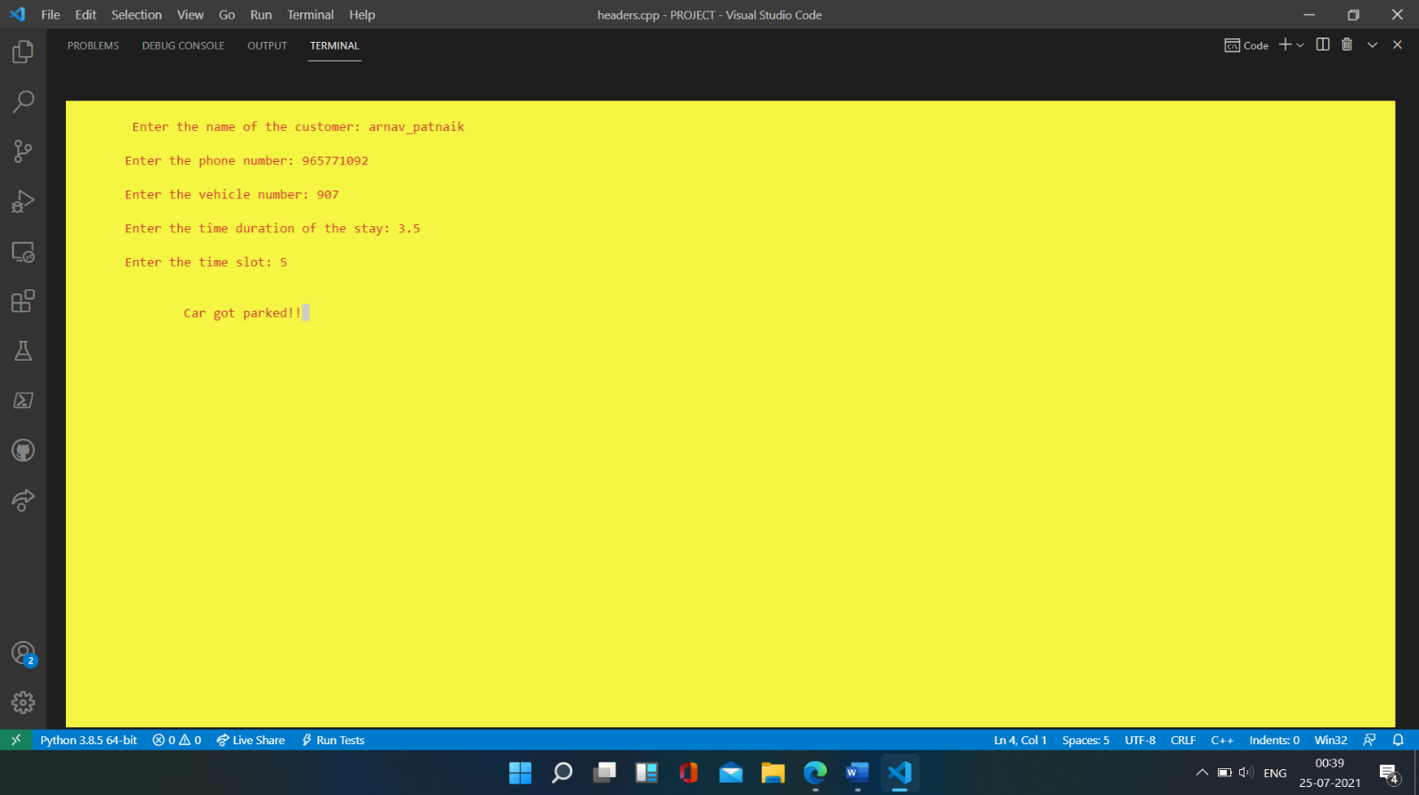
The 1st option allows the user to book a slot for the customer saving all the required details.

Slide 12
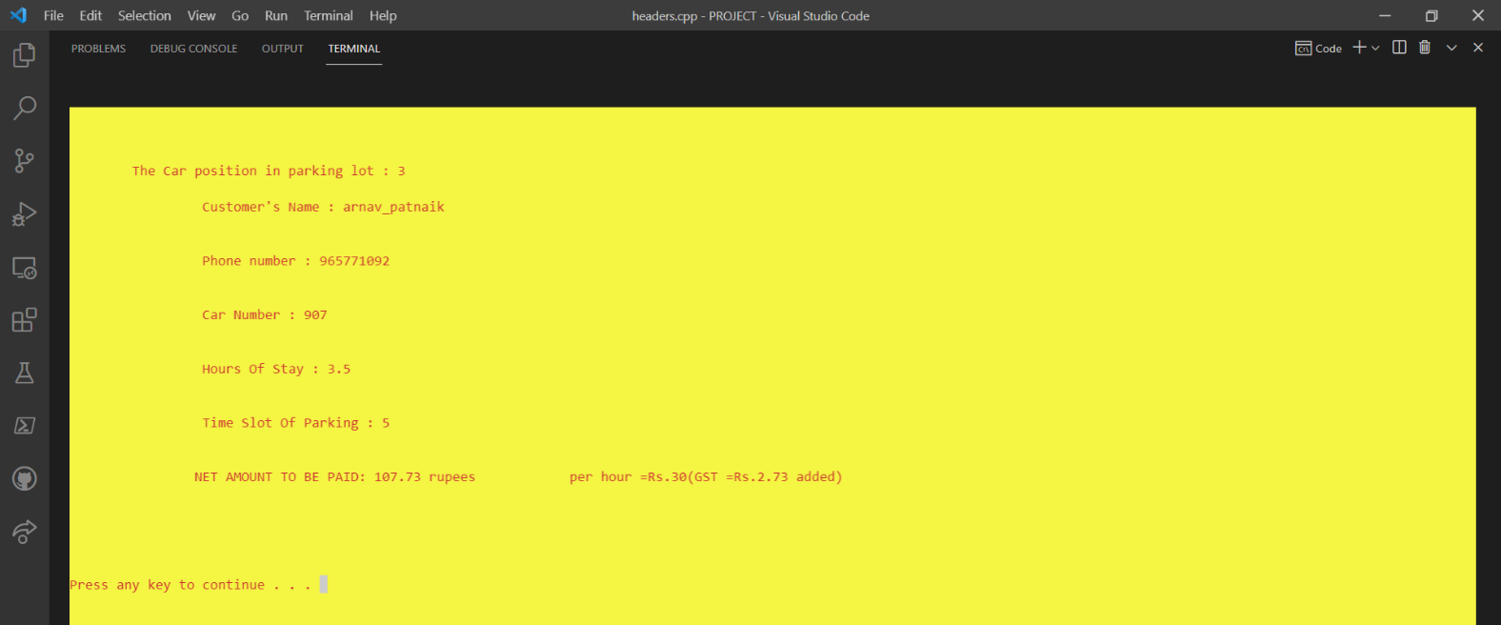
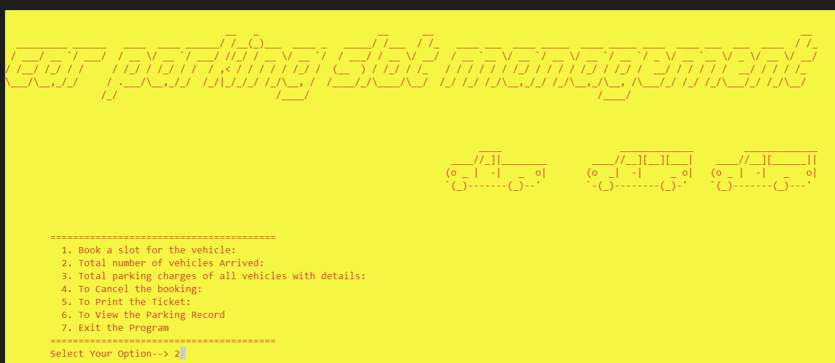

The 2nd option allows to check that which all vehicles have occupied the slots .

Slide 13
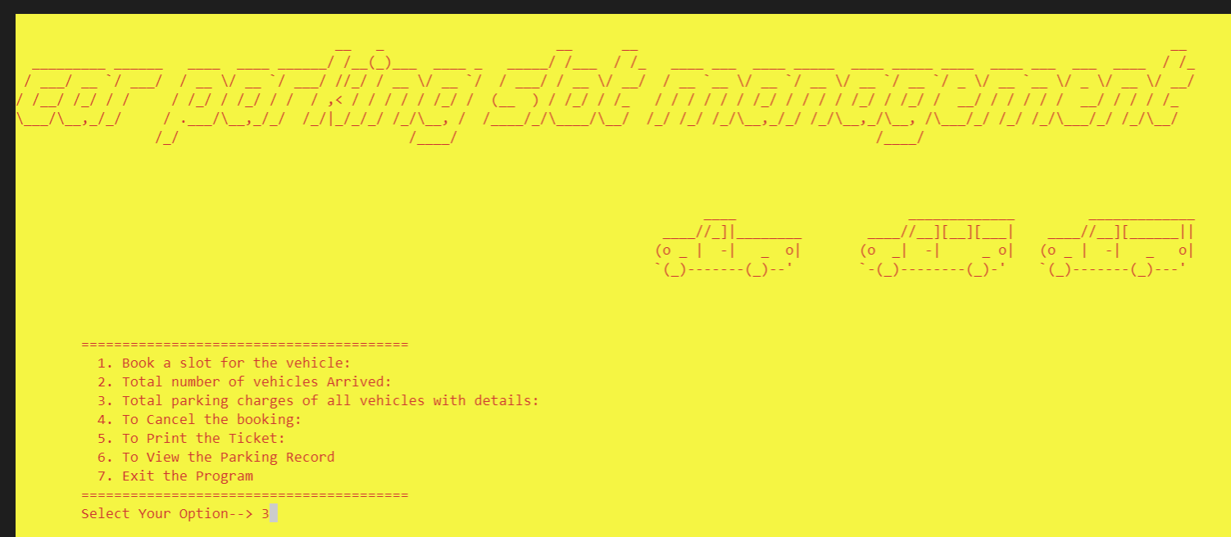
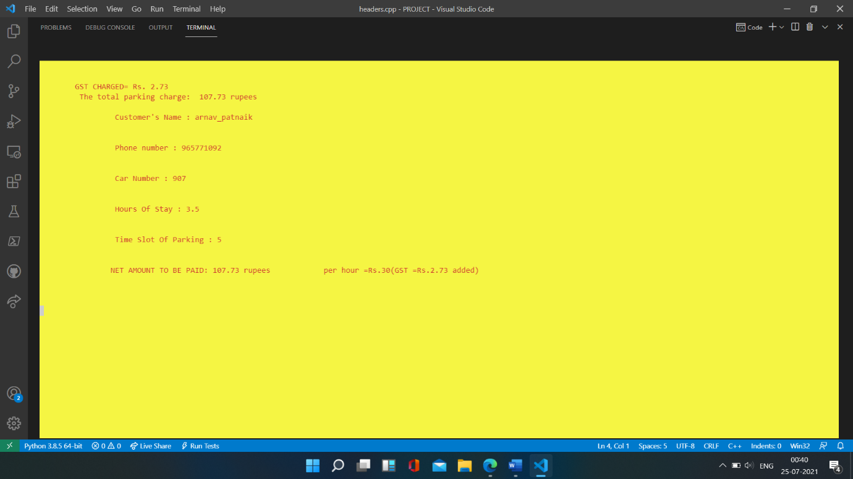
The 3rd option displays the amount to be charged from the different customers who have parked their vehicles.

Slide 14

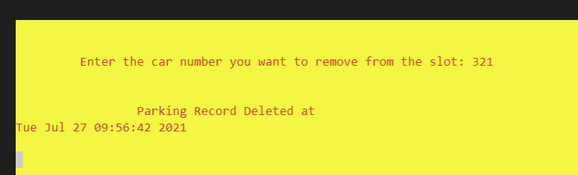
The 4th option allows the user to delete a particular customers data from his record.
It also shows the time and date as to when the record is deleted.

Slide 15
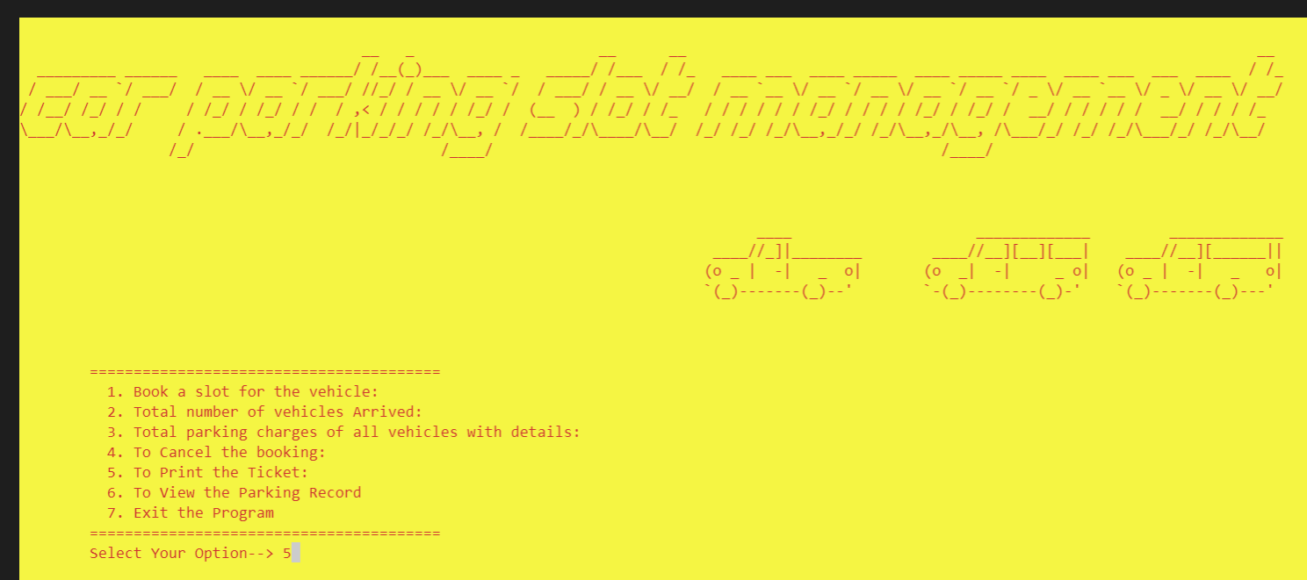
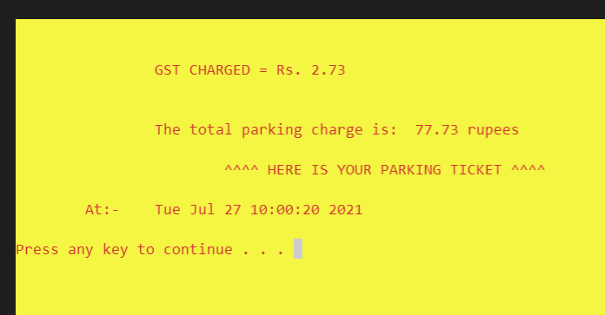
The 5th option allows the user to print ticket for the customer whose vehicles has been parked.

Slide 16

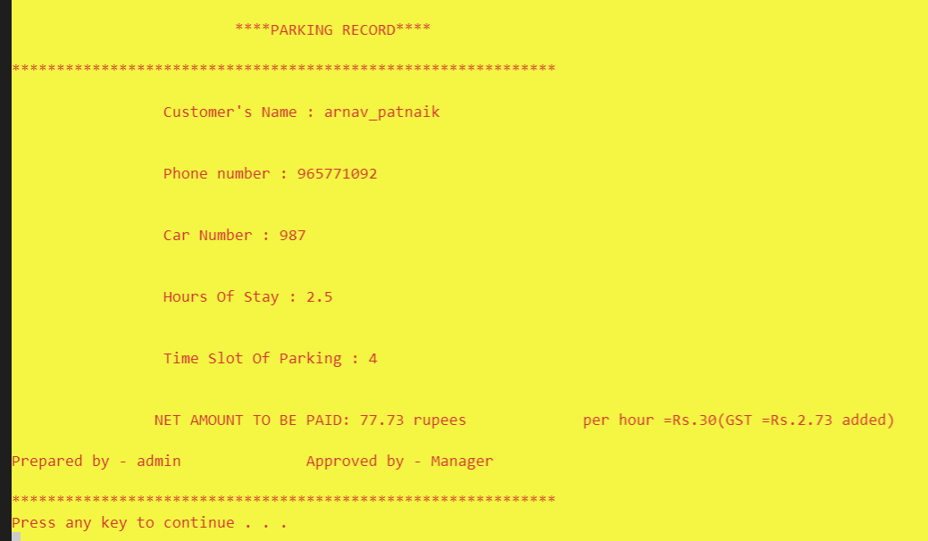
The 6th option allows the user to view the parking records.

Slide 17

The 7th option allows the user to exit the program.

Slide 18
Conclusion
This project work aims at providing an efficient car parking management system based on compiler programs and CCTV cameras.
CCTV cameras are used to keep a check on the slots and with the help of the program, we can store and keep a record for the same.
The prime focus of this study was to introduce a system in which car parking can be managed efficiently without causing any hassle to the driver as well as the general public.
LIMITATIONS:
Excel or pdf reports cannot be generated.
The system works in offline mode, hence modification of data for a vehicle's parking duration fees in online mode will not be possible.
Initial set up of the system in real life can be expensive as one has to invest in a pc, CCTV camera’s, etc.
This system is not fully automated, so it will require manpower.

Slide 19
Future Scope
To develop our program into an online application with the help of IOT.
Future versions of this program would be completely automatic and self – controlled using cameras, sensors and LED's and wireless displays, etc.
To make the system fully automated with least manpower possible.

Slide 20
References
[1] Research and markets- India Vehicle Purchase Preferences Report 2021
[2] McKinsey & Company- Marketing & Sales report
[3] UBC SMART PARKING SYSTEM
[4] WIKIPEDIA-The free encyclopedia
[5] MOBILEVIDEOGUARD.COM
[6] Black box- analogue and ip cameras
[7] PARKOFFICE
[8] VERSIONX
[9] BOOKINGNINJAS
[10] Design and Implementation of Smart Car Parking System, Modelling and Simulation -P B Natarajan, Samit Kumar Ghosh, pg.4-7
[11] A Comparative review on Car Parking Technologies- R. Ranjini, D. Manivannan, pg.1-5

